Slide 1
Feedback Alignment in Deep Convolutional Networks
1

Slide 2


Hello!
I am Tina Gholami.
Western University
Computer Science Department, Brain-inspired AI
Prof. Yalda Mohsenzade
2

Slide 3
Outline
1. Introduction
2. Related Work
3. Feedback Alignment Method
4. Results
5. Scaling to Deeper Networks
6. Summary
3

Slide 4
1. Introduction
4

Slide 5
Introduction
Studies -> similarities between neural representations in biological networks and in deep artificial neural networks
Develop -> analogies between the backpropagation algorithm in artificial networks and the synaptic activity in the brain (reconcile)
Challenges -> biologically implausible features of backpropagation:
Symmetry in the forward and backward synaptic weights (weight transport problem) (observed in the brain) -> methods -> fail to scale
Feedback Alignment method -> enforces a weaker form of weight symmetry -> requires agreement of weight sign but not magnitude -> good performance as BP
5

Slide 6
2. Related Work
6

Slide 7
Related Work
MNIST handwritten digit dataset
CNNs
1. FA was competitive with BP on this dataset.
2. Also, on a random input-output task in multilayer fully-connected networks
3. As training progresses, the FA weight updates are correlated with but not identical to those in BP.
1. Testing performance on a variety of tasks including visual and auditory classification
2. Without additional modifications, the performance of FA was substantially worse than BP
3. three modifications:
(i) uniform sign-concordant feedback (USF): the feedback matrix B is set to B = sign(W)
(ii) Batch Normalization
(iii) Batch Manhattan: the magnitude of the gradient is discarded -> avoid vanishing/exploding gradients
7

Slide 8
Related Work
Direct Feedback Alignment (DFA)
CIFAR-10 and ImageNet
Xiao et al. (2018b)
1. The output layer error signal is propagated directly to all upstream layers instead of through adjacent layers as in standard BP and FA.
1. improved biological plausibility -> eschewing the weight-sharing in convolutional layers -> substantially improved generalization in CNNs
2. Model in this paper also uses weight sharing
3. Methods improving biological plausibility -> All struggled when applied to deep networks
1. Released results similar to this paper on even deeper networks
2. All these results provide strong evidence that sign-concordant feedback improves performance compared to random feedback.
8

Slide 9
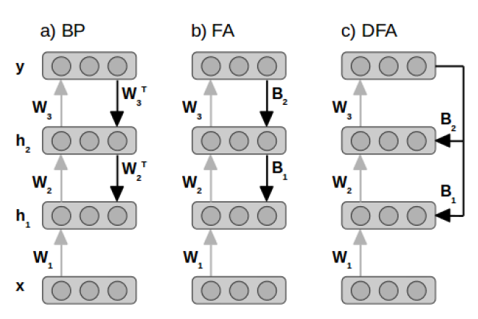
BP, FA, and DFA Architecture
https://medium.com/@SeoJaeDuk/nips-2016-direct-feedback-alignment-provides-learning-in-deep-neural-networks-with-interactive-32d59045e8e
9

Slide 10
3. Feedback Alignment Method
10

Slide 11


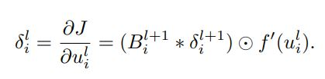

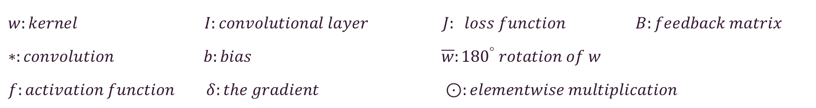
Feedback Alignment Method (FA)
Implementation of FA in CNNs (similar to FFNNs)
Step 01
Step 02
$w:kernel I:convolutional layer J: loss function$ $B:feedback matrix$
$∗:convolution b:bias$ $\overline{w}:{180}^{°} rotation of w$
$f:activation function$ $δ:the gradient$ $⊙:elementwise multiplication$
11

Slide 12

Modification to FA
Modifications: improve performance by reducing the possibility of vanishing or exploding gradients and encouraging angular alignment between the feedforward and feedback weights.
Initialization (Init.) Method:
$$\left|.\right| :elementwise absolute valuefunction t:training iteration$$
This modification to USF uses no information about the magnitude of the current forward weights, the initialization “Init.” method
12

Slide 13

Modification to FA
Excitatory/Inhibitory (E/I) Method:
freezing the sign of the forward weights after a certain number of epochs of training -> keeping network’s synaptic connections either excitatory (positive) or inhibitory (negative)
Strict Normalization (SN) Method:
13

Slide 14
4. Results
14

Slide 15
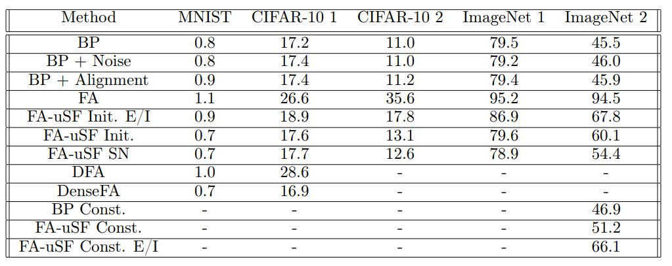
Results
The mentioned modification:
Applied on CNN
Tested on visual classification
MNIST handwritten digits, CIFAR-10, ImageNet dataset
15

Slide 16
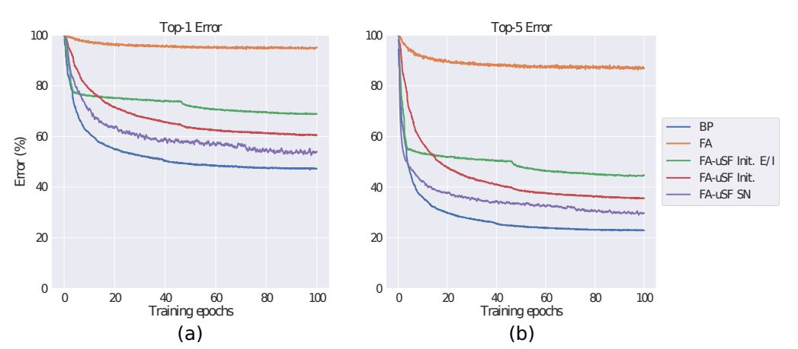
Results
The results on ImageNet:
The feedback alignment methods are competitive with, and in some cases exceed, backpropagation performance.
16

Slide 17
5. Scaling to Deeper Networks
17

Slide 18


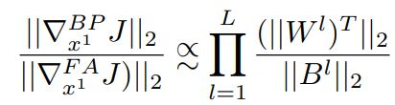
1. Vanishing and Exploding Activations and Error Signals
The gradient with respect to the first layer’s activation $x^{1}$ is:
And at each layer:
The weights assumed to be independent: (Euclidean norm.)
Nominator -> cte, Denominator -> cte, Also this issue in deeper networks-> exponential
18

Slide 19
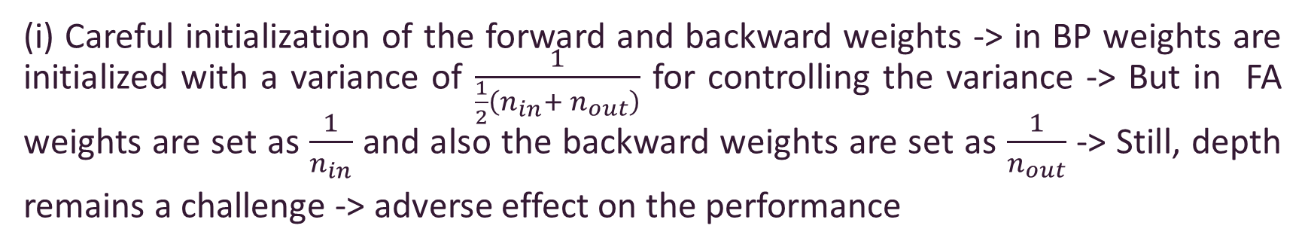
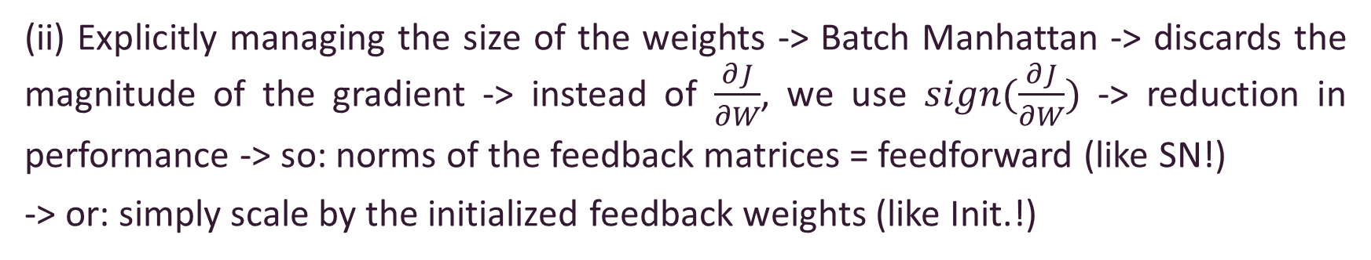
Solutions:
(i) Careful initialization of the forward and backward weights -> in BP weights are initialized with a variance of $\frac{1}{\frac{1}{2}\left(n_{in}+ n_{out}\right)}$ for controlling the variance -> But in FA weights are set as $\frac{1}{n_{in}}$ and also the backward weights are set as $\frac{1}{n_{out}}$ -> Still, depth remains a challenge -> adverse effect on the performance
(ii) Explicitly managing the size of the weights -> Batch Manhattan -> discards the magnitude of the gradient -> instead of $\frac{∂J}{∂W}$, we use $sign(\frac{∂J}{∂W})$ -> reduction in performance -> so: norms of the feedback matrices = feedforward (like SN!)
-> or: simply scale by the initialized feedback weights (like Init.!)
19

Slide 20
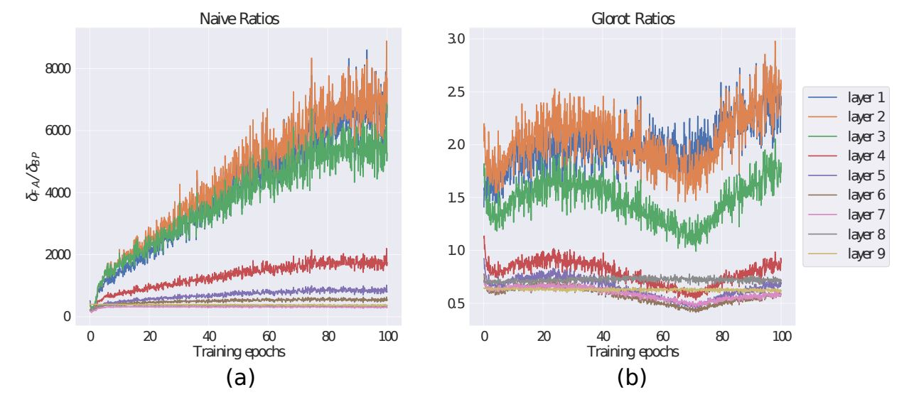
Result in implementation:
Results of (i):
20

Slide 21
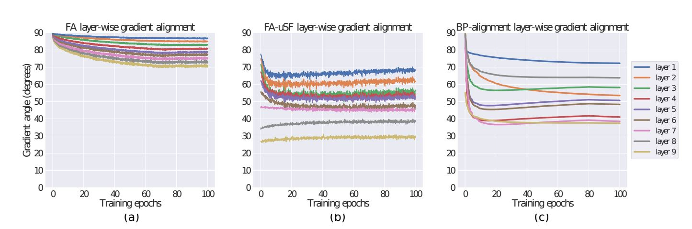
2. Gradient Signal Alignment
In shallow networks, as training progresses, the signal calculated in FA and the gradient used by BP are roughly orthogonal at initialization but that the angle between them converges to approximately 45◦ by the end of training -> But in deeper networks there is less alignment
Solution: USF is applied -> the angle quickly drops below 90◦ but then rises up-> weight more tightly distributes at the first
21

Slide 22
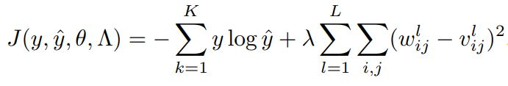
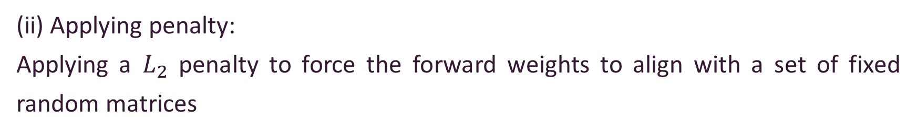
3. Modifications to BP
Relationship between alignment and performance -> so, training the model using BP but with modifications so that it mimic FA
(i) Adding noise:
The angle between the noisy learning signals and that of the true gradients remained at roughly 45◦ -> like FA with uSF!
(ii) Applying penalty:
Applying a $L_{2}$ penalty to force the forward weights to align with a set of fixed random matrices
22

Slide 23
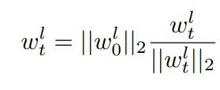
4. Constraining the Magnitude of the Weights
Trained several models on ImageNet in which the norm of the forward weights was adjusted after each training iteration
And by Using a variance-preserving initialization method, there is no need for additional mechanisms to normalize the backward weights as the forward weights change -> does not affect BP, but improves the performance using FA with 51.2% Top-1 error
23

Slide 24
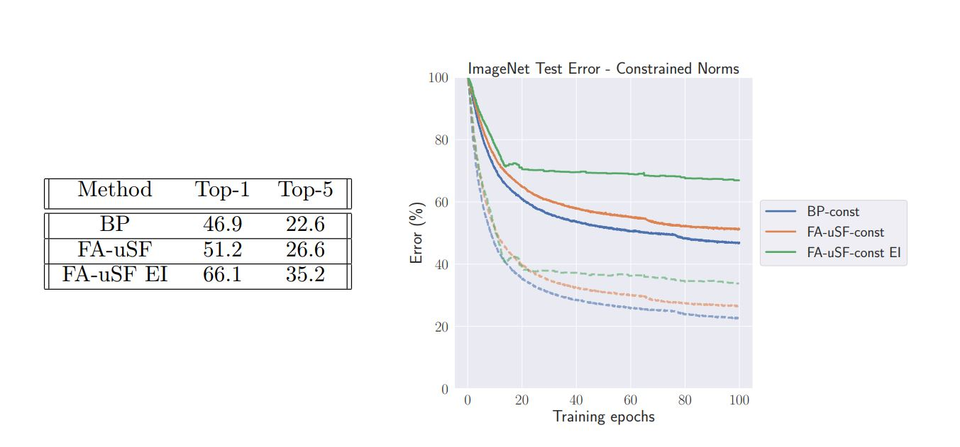
Results:
narrows the gap between BP and FA:
24

Slide 25
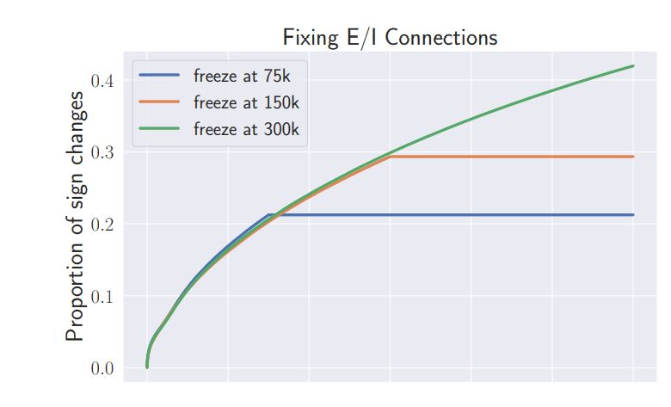
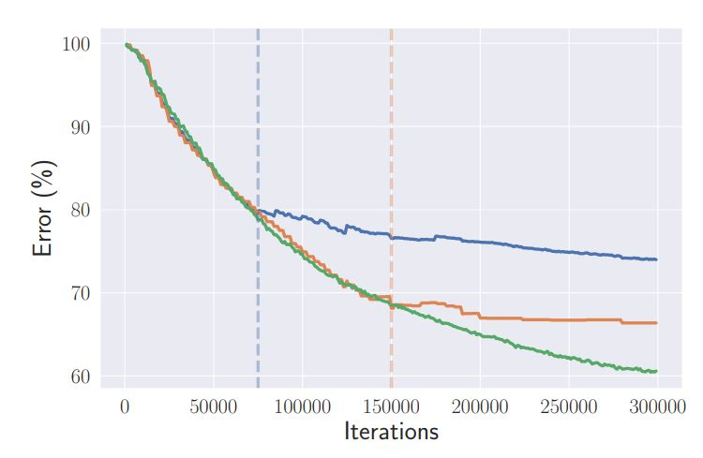
5. Effect of Constrained Weight Signs
Freezing weight signs has a significant negative impact on learning (the green line in the previous table) -> depends whether if weights stabilize before freezing them or not->E/I identities are not fixed even late in training -> Accordingly, constraining weight signs dramatically reduces the speed of learning, even if the constraints are applied late in training -> Challenge because Synapses’ signs are fixed
25

Slide 26
6. Summary
26

Slide 27
Summary
Modified FA learning algorithms can perform with accuracy which is competitive with BP even for deep CNNs
Controlling the magnitude of the error signal by using the three suggested normalization methods, also weight initialization, and encouraging alignment
Employing these methods along with fixed weight norms allow our model to reach an ImageNet Top-1 error of 51.2% -> competitive with BP!
Fixing the feedforward weight norm (method 4) showed the best results -> since it regulates the forward pass and normalizes the backward weights appropriately may be sufficient to achieve high performance.
There are adverse effects of enforcing fixed E/I connections (method 5)
27

Slide 28
References
Paper: Feedback Alignment in Deep Convolutional Networks, Theodore H. Moskovitz, Ashok Litwin-Kumar, and L.F. Abbott, arXiv, 10 June 2019
More info on direct feedback alignment method (FDA) in section 2:
https://www.youtube.com/watch?v=Hdo81GtLC_4
https://medium.com/@SeoJaeDuk/nips-2016-direct-feedback-alignment-provides-learning-in-deep-neural-networks-with-interactive-32d59045e8e
28

Slide 29
Thanks!
Any questions?
You can find me at:
tgholam2@uwo.ca
29

